Slide 1

Society Management System
Submitted By:
Mahesh Bhabhad (220943020055)
Tarun Rathore (220943020099)
Nikhil Madhekar (220943020052)
Mohsin Naqvi (220943020079)
Guided By:
Mrs: Bakul Joshi

Slide 2
Contents
Introduction
Problem Statement
Working
Features
Applications
Technologies Used
Conclusion
Future Scope
Conclusion

Slide 3
Introduction
The online carpooling system is a platform designed
to connect individuals who are traveling in the
same direction so they canshare a ride together.
It aims to provide a more sustainable and cost-effective
transportation option by reducing the number of vehicles
on the road and optimizing the use of existing resources.
Notes:
Hive and Hive QL statements have been used for querying the data.
For future scope, various different Machine Learning algo0rithm will be implemented on different flight delay datasets.

Slide 4
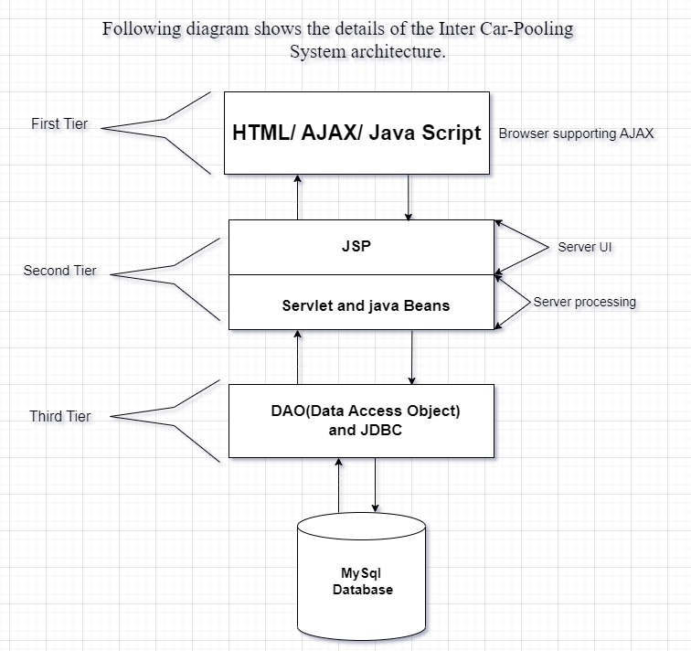
Technology platform used for Project

Slide 5
Roles and responsibitities
Roles
User
Passenger
Admin
Responsibilities of each user
User-
Passenger-get benifited from appln.
Admin-Account management, permission to allow users and car-owner passenger.
User cases of each user
User-
Passenger-update profile
Admin-allow car-owner,

Slide 6
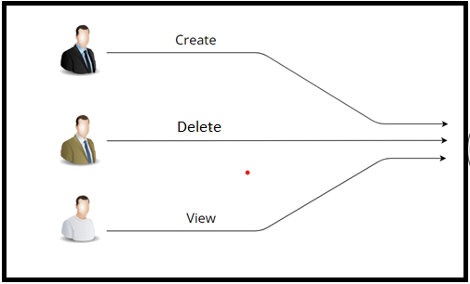
Working

Slide 7
Features
Admin can Allow Car-owners.
Admin can can delete Car-owner account.
Admin can manage account details.
User can create ride.
Car owner can add details and register ourself.
Car owner and user can create ride,delete ride.
Car owner can update his details.
User can add review to ride .
New user can be registered .

Slide 8
Benefits
Private Vehicle Owners: Individuals who own a car and offer rides to other users through the carpooling system.
It is very easy to use.
The individuals who have cars seats available for share transportation with others.
It saves a lot of time and money .
Eco-friendly: Government and Regulatory Authorities: Reduce traffic congestion and promote sustainable transportation.
Travelers: People who use carpooling for long-distance trips.

Slide 9
Benefits
Passenger seek shared rides with drivers heading towards in the same city. It provides custom features development and support with the application.

Slide 10
Technologies Used
React JS, Bootstrap-(Front-End).
Java, Spring-Boot REST API, JPA-(Middle-Tier).
MySQL-(Back-End).

Slide 11
Conclusion
Inter-city car pooling system are potential solutions that could mitigate environmental pollution and urban congestion and provide cost savings for their users.
The aim of this project is to reduce the travelling cost, while travelling through private vehicles like car, cabs, etc from the same institute.

Slide 12
Future Scope
Carpooling is the sharing of car journeys so that more than one person travels in a car, and prevents the need for others to have to drive to a location themselves. Reduce traffic congestion – The benefits of carpooling on a large scale are huge. The software is flexible enough to be modified and implemented as per future requirements. We have tried our best to present this free and user–friendly website to Society members.

Slide 13
THANK YOU

